Slide 1
Chapter Sixteen: Philosophy, Art, and Literature
By Tommy Boss

Slide 2
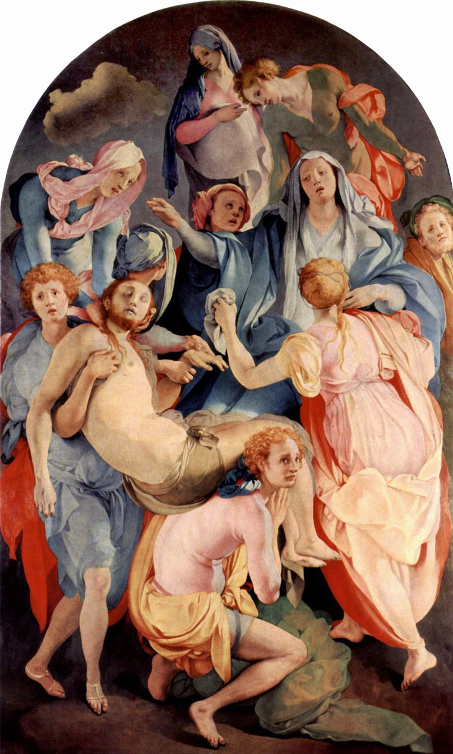
Mannerism
Mannerism in art is a style that focuses on the human body, often having unnatural poses to excaudate the body
Art often included unnatural coloration and distortion of objects
Bodies were often elongated and poses were often dramatized to present accent movement
Began during the late renaissance, around 1520
Arose in Florence and Rome, spread rapidly
Ended in 1580
The Deposition From the Cross by Jacobo Pontormo

Slide 3
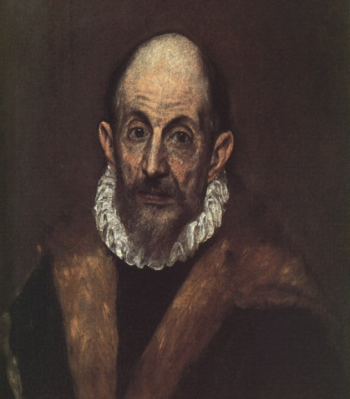
El Greco (The Greek) was a Spanish painter of Greek descent.
He moved to Rome to pursue painting, incorporating many mannerist techniques.
He often used unnatural lighting and dark colors to portray chaos and confusion.
El Greco is most noted for his religious works, expressing the widespread tension through mannerism
The Disrobing of Christ (left)
Self Portrait (right)

Slide 4
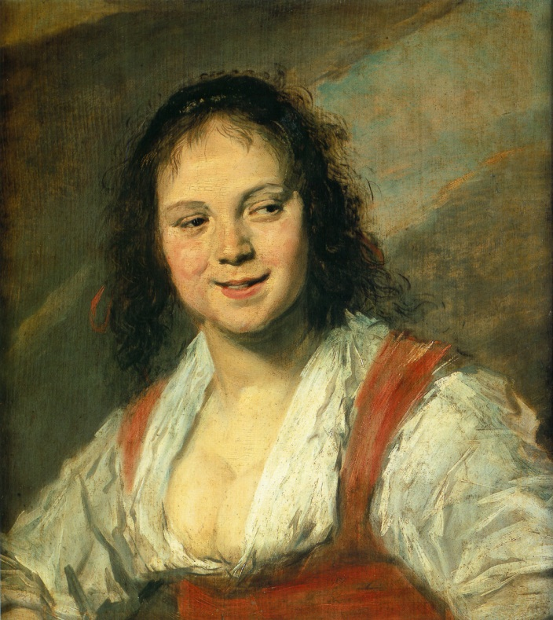
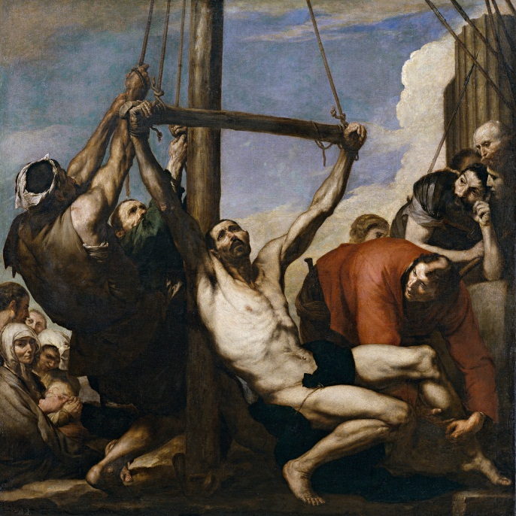
The Baroque
The Baroque was a period in which art was changing quickly
Scenes were typically large, dramatic, and meaningful. There was lots of color and motion
The Baroque art focused on imperfections, depicting flaws in image to create emotion and natural imagery
Religious themes were very common
In music, The Baroque brought new instruments and instrumentation to popular culture, including many new forms of opera and the development of the orchestra
Gypsy Girl by Frans Hals
Martyrdom of St. Phillip by Jose de Ribera

Slide 5
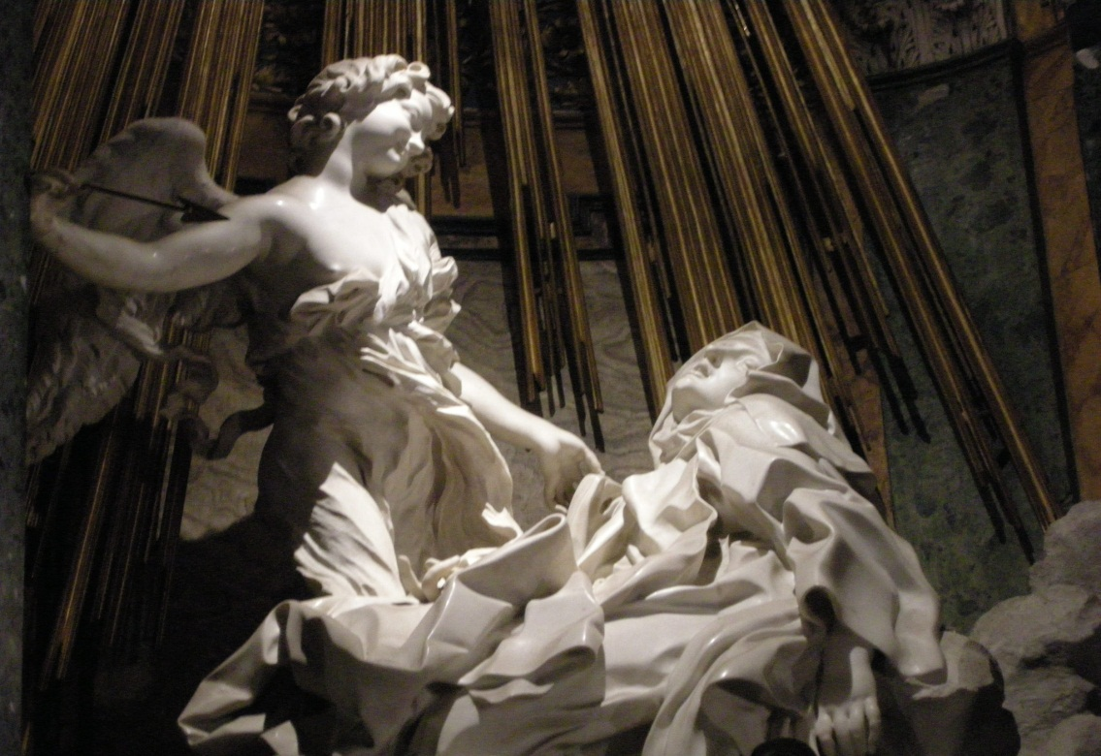
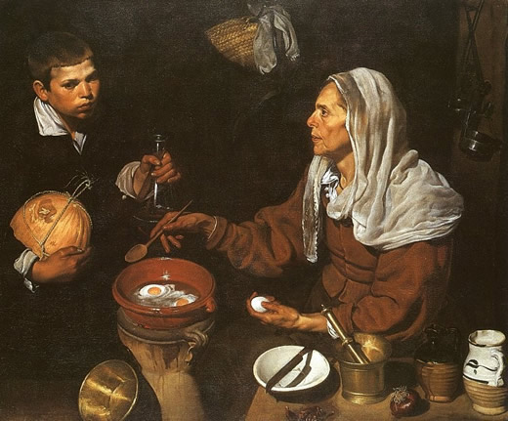
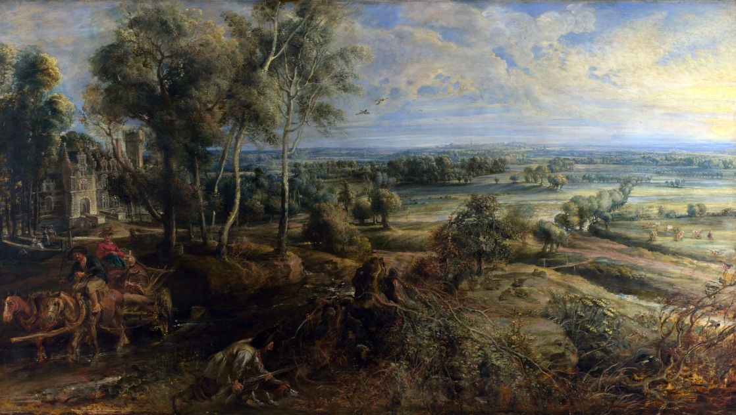
Conversion of St. Paul – Caravaggio (Top Left), Ecstasy of St. Theresa - Bernini(Top Right),
Woman Cooking Eggs- Velazquez (Bottom Left), The Chateau de Seen and Hunter- Rubens (Bottom Right)

Slide 6
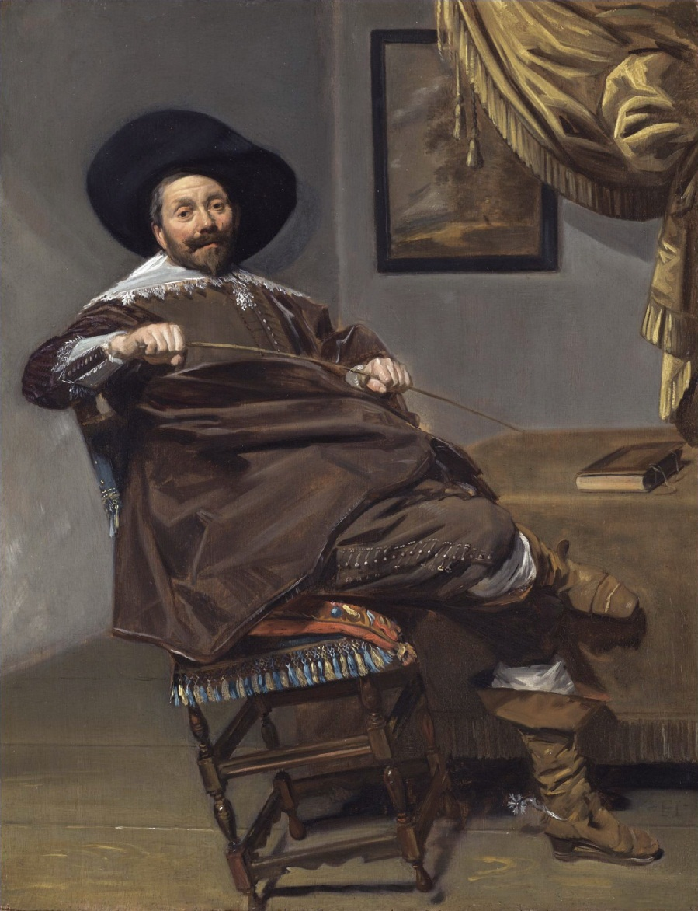
Classicism in Art
Classicism was the other dominant style during the 17th century
It was characterized by it’s replication of Greek and Roman style in painting, sculpture, and architecture
It was focused on aesthetics presented in a formal, clear way
This style was much better received at first. This was the style used in most courts as it portrayed the subject as perfect, unlike The Baroque
Willem Heythuijsen by Frans Hals

Slide 7
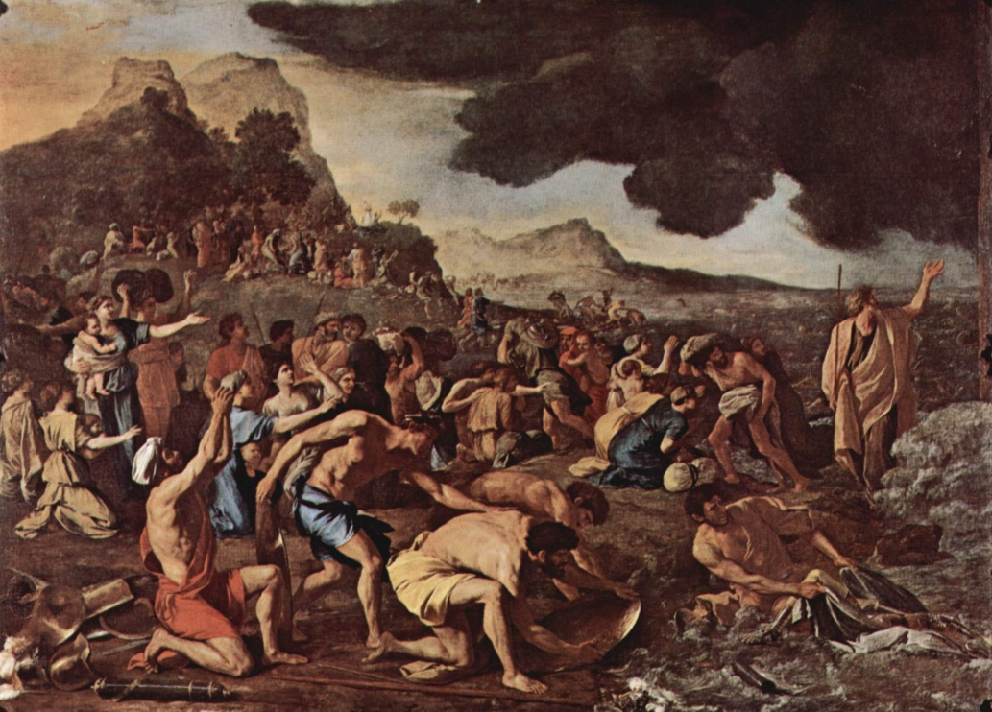
Poussin
Poussin was a French classical painter who spent most of his time in Rome
In his artwork, Poussin used figures and shapes to emphasize his work and tended to downplay color
He was a member of an informal academy of artists opposed to the Baroque movement
He was commissioned at one point to paint for Cardinal Richelieu, earning the title of First Painter of the King
The Crossing of the Red Sea

Slide 8
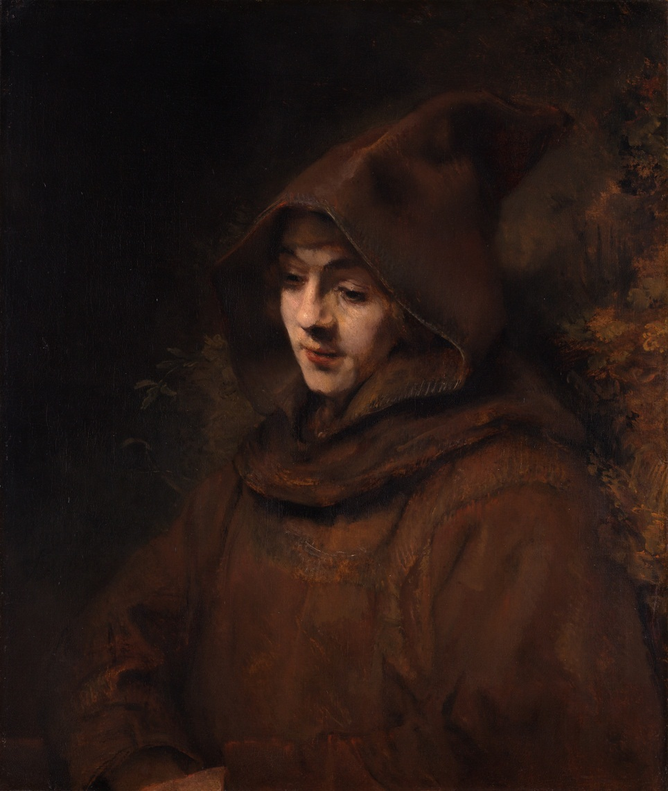
Dutch Classicism
In the United Provinces, the Church did not require religious works, so most paintings on the topic reflected personal faith
Because of the lack of a court, rich merchants and the upper class were the most common patrons of the arts
This led to very formal, restrained art
One of the most acclaimed artists from this scene was Rembrandt and his self portraits, over sixty in total, showing his progression over time, capturing his human essence. This idea was a key concept of the classicism movement
Rembrandt’s son Titus

Slide 9
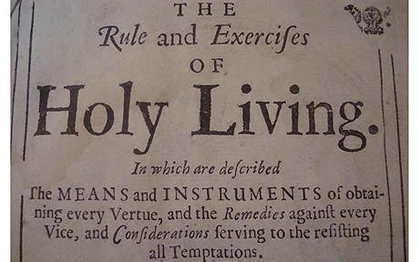
Literature
The political and religious tension in society was reflected in literature
One of the most common subjects to write about during the 17th century was the household, proper behavior, and gender roles, such as The Holy Roman Living (1674), describing proper conduct according to the Church
There were also an abundance of political novels, commonly revolving around the English revolution

Slide 10
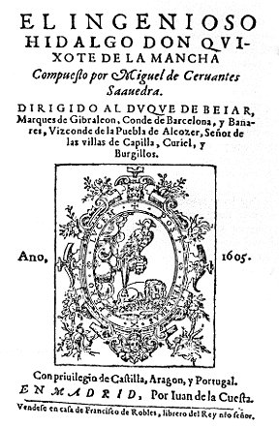
Cervantes
Cervantes’ works directly reflected the social struggles and defined classism in Spain
He avoided politics, and instead commented on human nature and interclass relations, pointing out flaws and foils of the public
In his most famous and influential work, Don Quixote, Cervantes points out the impossibility of chivalry in contrast to the ruthlessness and very real state that was 17th century Spain

Slide 11
Shakespeare and Theatre
The theatre became hugely popular in the 16th and 17th century, a leading art form of the time
Playwrights covered topics from histories glorifying their nation to epic tales of romance and valor
Plays, unlike art such as the opera and painting, was available to everyone, even the peasants
Actors were common, and so were plays, making theatre a central component of cultural life, endorsed by royalty and peasants alike
While interrupted by the civil war and plague, theatre continued to stay relevant, however it was often a very unsanitary and disease ridden mess
Acting groups and playwrights were usually members of a royal acting company, supported by nobles and royalty

Slide 12
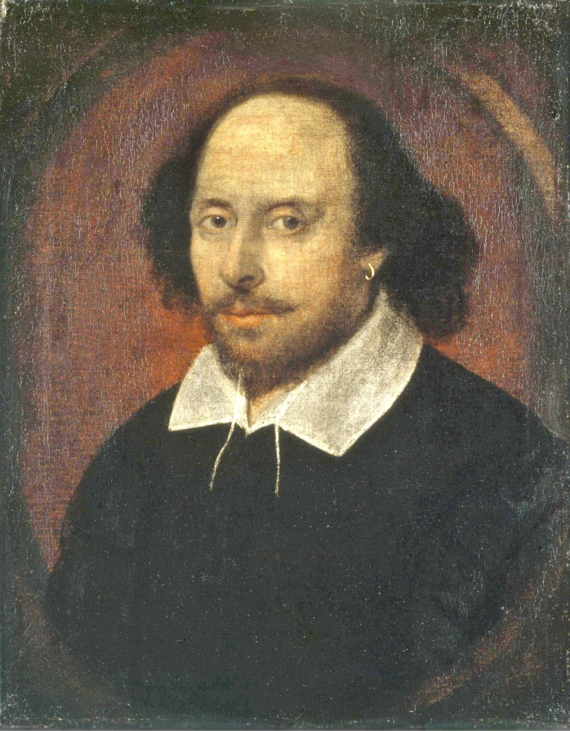
Shakespeare is arguably the most influential writer of all time, effectively creating plays that continue to stay relevant and socially accurate 400 years after being written. His statements on human nature and his ability to make statements that remain true even in the modern world we live in today
He did however often reflect on the mindset unique to that time period, putting forth formality and stability as virtuous, showing the goals and expectations of the 17th century worldview
Because of his popularity with both the public and the upper class, Shakespeare wrote constantly, putting out 28 plays and over 150 sonnets ranging from comedies to histories to tragedies

Slide 13
Philosophy
The scientific milestones of the 17th century brought on a philosophical boom on a comparable scale
The introduction of the scientific method and discoveries brought on new ways of thought and conflicting ideas
Politically, war in England amongst other factors, had stirred many different views on an ideal government, which ranged from absolutism to democracy
Nations would often have conflicting ideals as a state on these subjects, adding to the growing feeling of nationalism in their philosophy and diversifying government systems throughout Europe

Slide 14
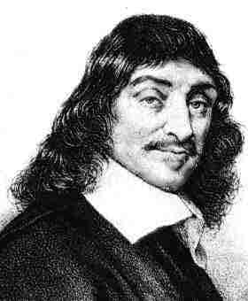
Descartes
René Descartes, author of Discourse on Method of Rightly Conducting the Reason and Seeking Truth in the Sciences, was a French philosopher who formulated the principle of doubt
This theory of doubt said that to know anything for certain, one must discard all previous biases and understand that your senses may deceive. Descartes took everything he believed to be true and applied it to the theory of doubt
He came up with two great and absolute truths
He knew he was doubting and therefore thinking, so he must exist
Humans know they are not perfect, and because they have a vision of perfection, there must be a perfect being, therefore God must exist

Slide 15
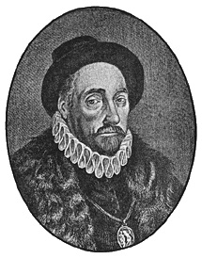
Montaigne and the Essay
Montaigne was a French philosopher during the scientific revolution, who, unlike many thinkers at the time, doubted that one could ever really find truth
He wrote a series of short persuasive papers on his opinions and ideas regarding various topics, essentially creating the modern day essay
Along with it he was a strong figure in the skepticism movement, arguing that all truths we have are in ourselves; that all that should be sought is inner truth, as nothing more is attainable

Slide 16
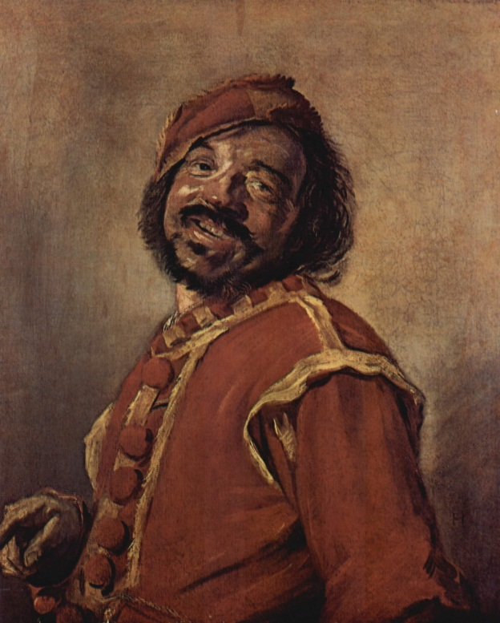
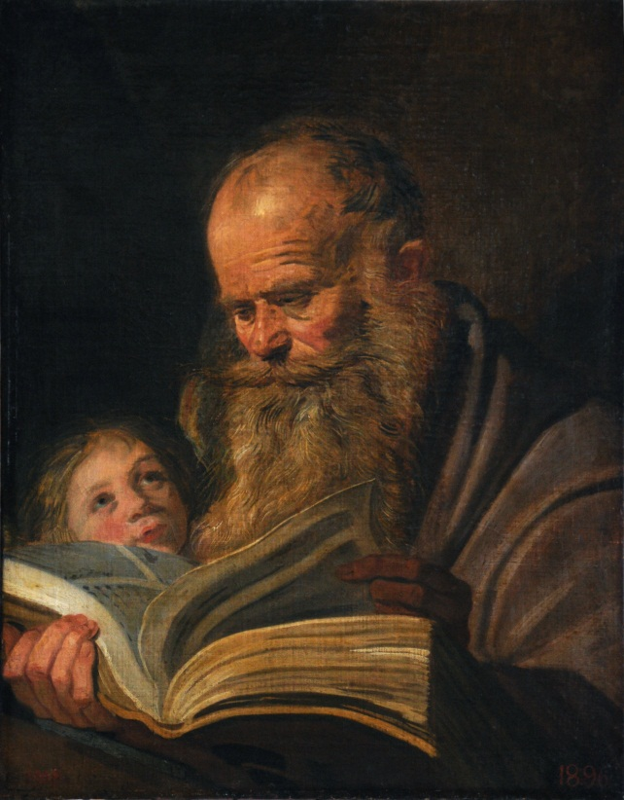
The End (More artwork by Frans Hals because I like him a lot)

